Slide 1
336018 – נושאים מתקדמים בהנדסה ביורפואית 4: מדעי המידע ולמידת מכונה בהנדסה ביורפואית Data science and machine learning in bio-medical engineering
Lecture 3
Data visualization

Slide 2
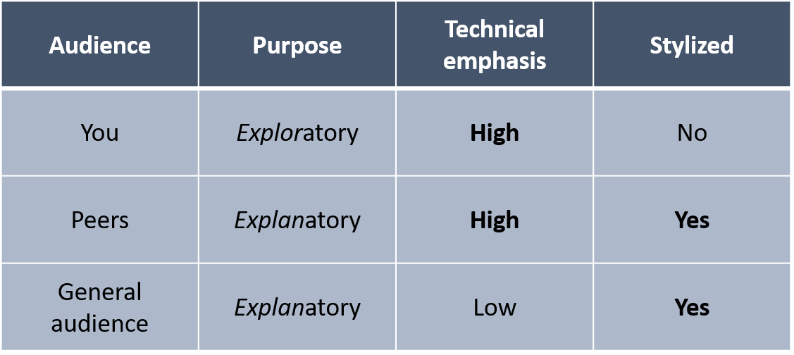
Intro to data visualization (“DataViz”)
“DataViz” is the visual representation of quantitative information.
It is a crucial part of any data analysis!
The specific style of a visualization is dictated by its target audience:

Slide 3
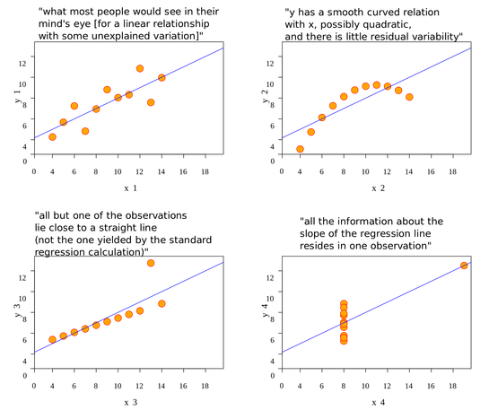
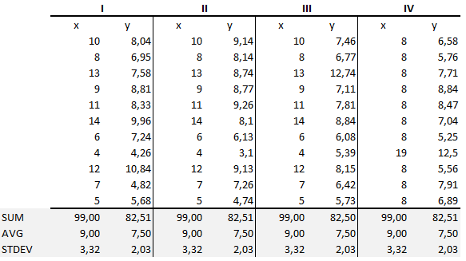
Why do we need dataviz?
Aren’t summary statistics enough?
Classic example:
“Anscombe’s Quartet” (1973)
0:

Slide 4

Why do we need dataviz?
Aren’t summary statistics enough?
Second example – “The datasaurus dozen” (Alberto Cairo):
"The Datasaurus Dozen"

Slide 5
Examples of great visualizations
WSJ - The impact of vaccines
A day in the life of Americans

Slide 6

Visualizations don’t need to be limited to a single variable

Slide 7
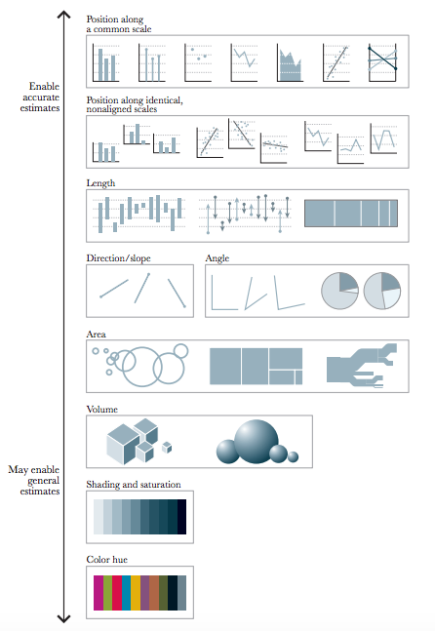
All visualizations are not created equal
Cleveland & McGill (1984) studied what people are able to decode most accurately and ranked them along the following scale:

Slide 8
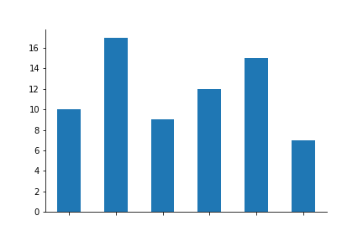


Example
Same data, plotted three different ways:

Slide 9
Some common problems/mistakes with visualizations
Visualizations are designed to exploit our natural ability for pattern recognition.
This can be skewed with:
Confounding axes limits (axis cropping)
Bad aspect ratio
Bad color choices
And more…

Slide 10
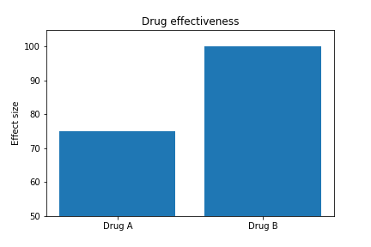
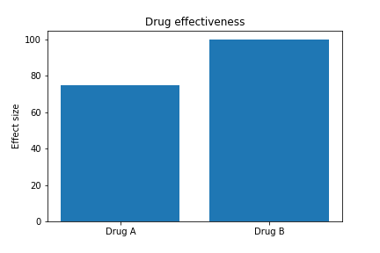
Confounding axes limits

Slide 11
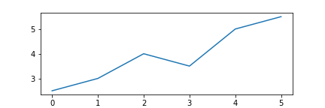
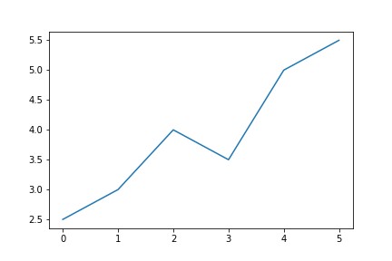
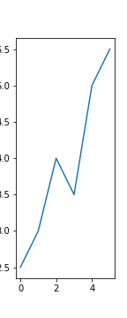
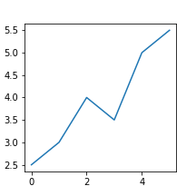
Bad aspect ratio

Slide 12
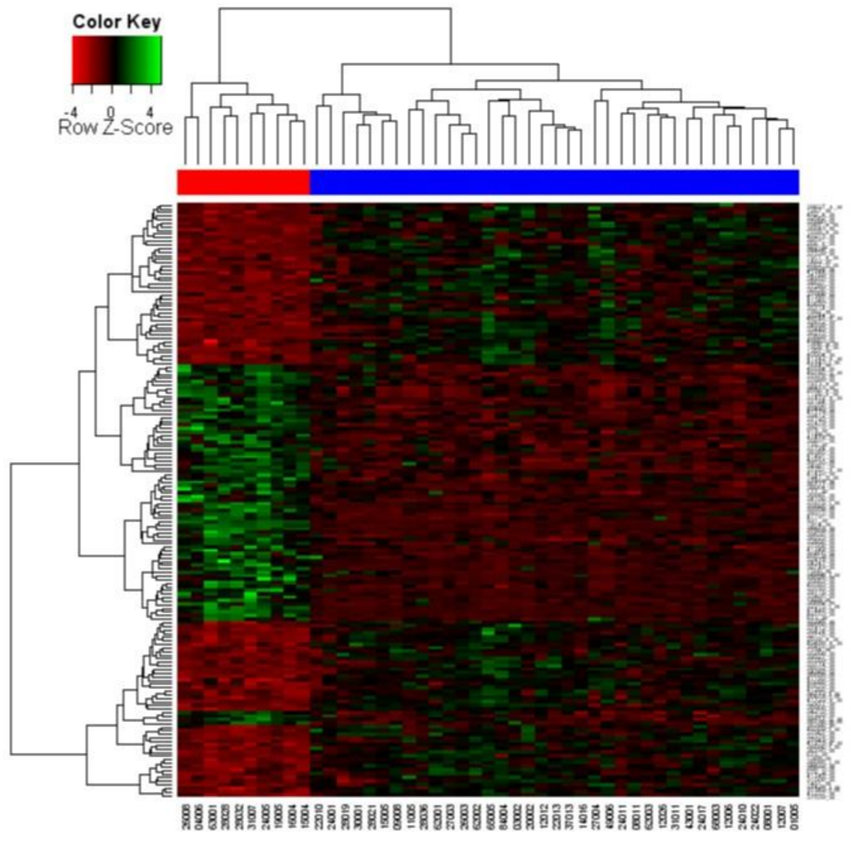
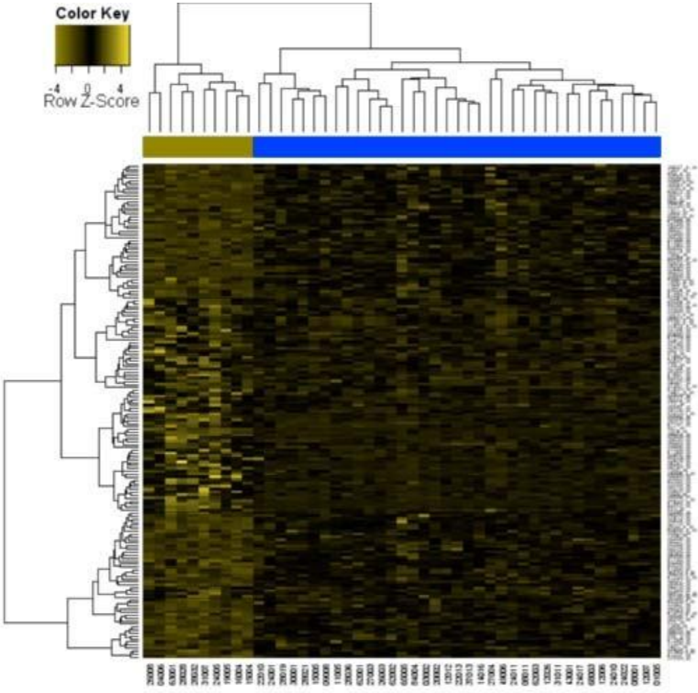
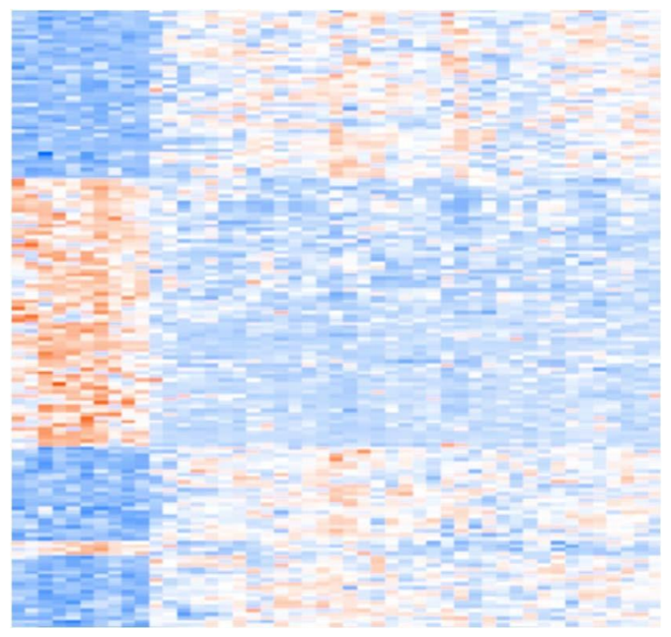
Problematic color choices

Slide 13
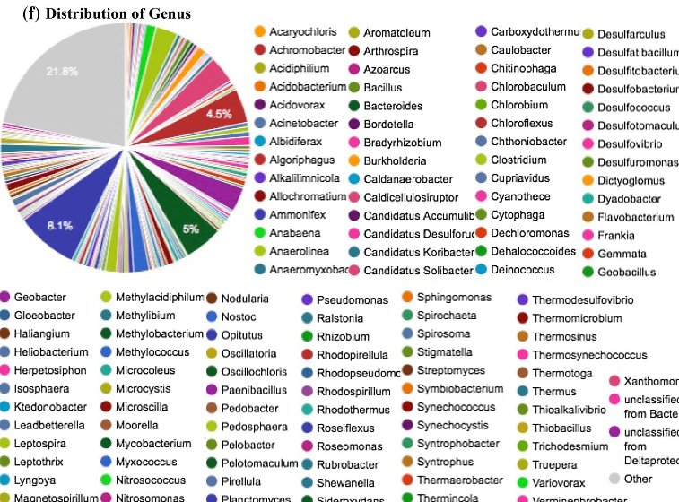
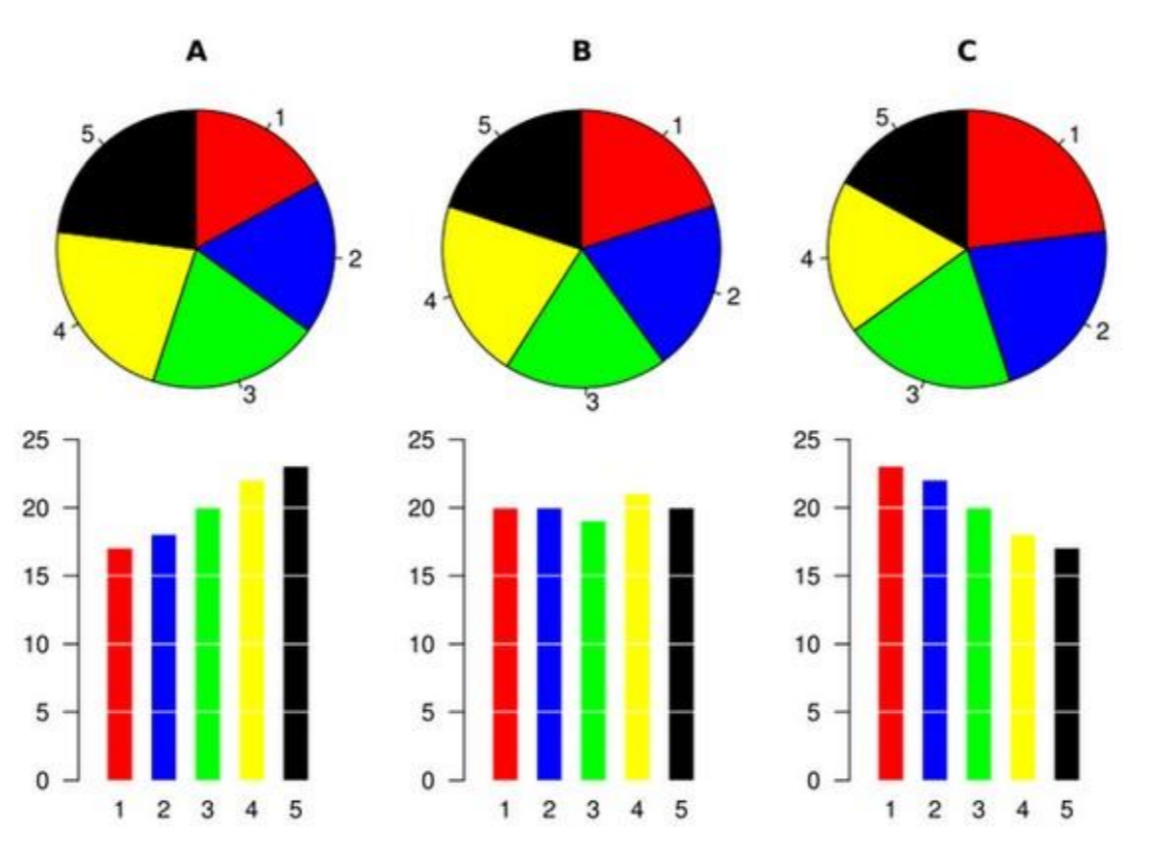
Beware the pie chart

Slide 14
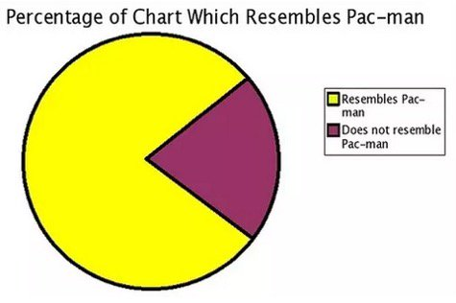
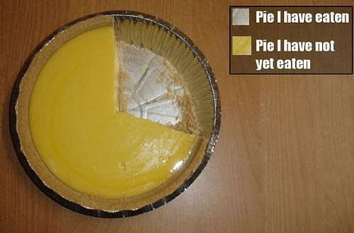
If you insist on using a pie chart
Show as few quantities as possible
Annotate with actual numbers, or preferably – percentages
Align with 0deg or 90deg
28%
72%

Slide 15
If you insist on using a pie chart
28%
72%
Show as few quantities as possible
Annotate with actual numbers, or preferably – percentages
Align with 0deg or 90deg

Slide 16
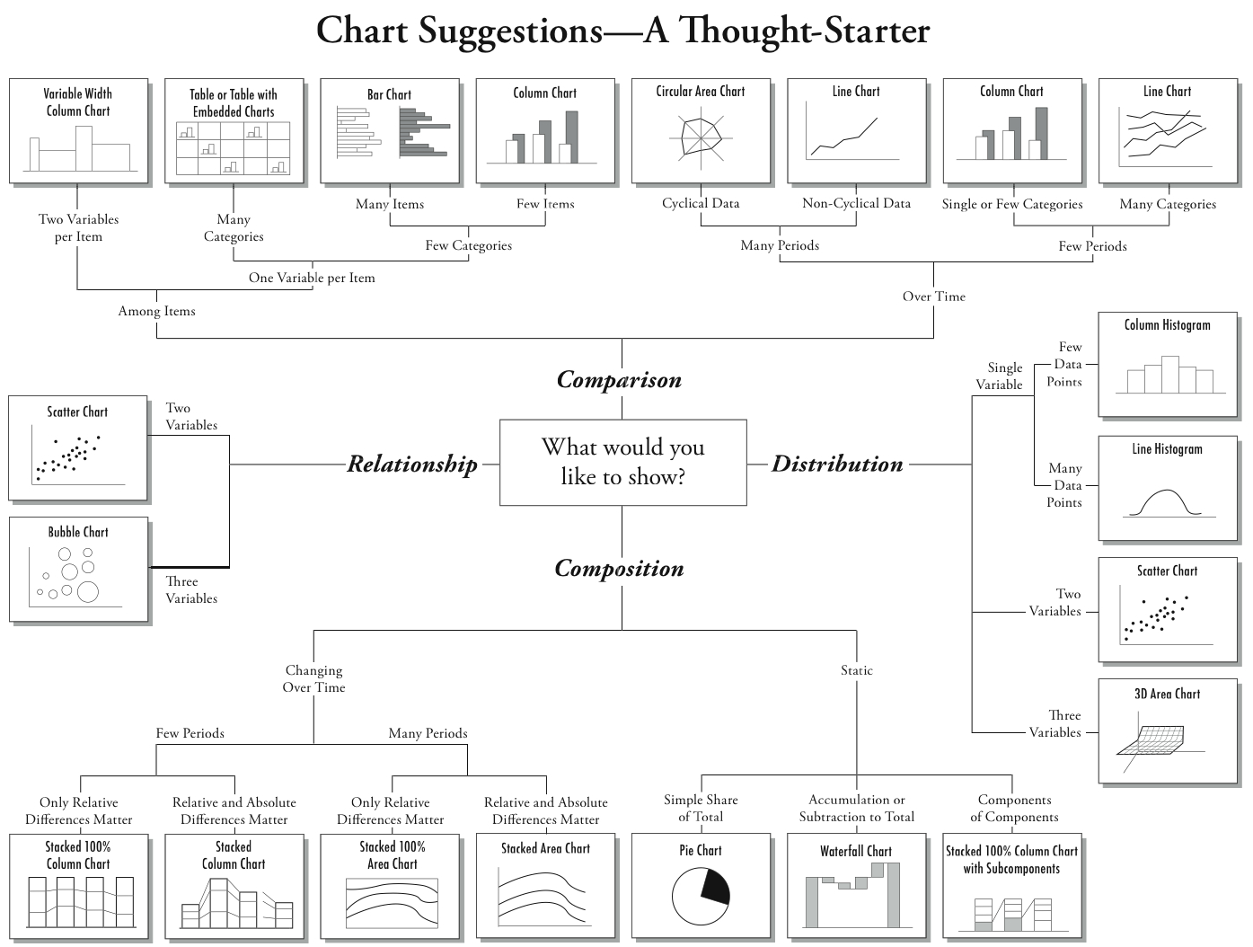

Slide 17

Back to the notebook!
We will cover:
Basics of plotting with matplotlib
Useful plotting tools for data science:
pandas built-in plotting functionality
Seaborn
A couple of real-world examples

